Slide 2
DVD
Let’s watch a DVD…
2-2
Notes:
Instructor Notes
Play the Overview of Foodborne Microorganisms and Allergens DVD.

Slide 3
Review
Let’s review
2-3
Notes:
Instructor Notes
Use the next several slides to review the content presented.
To ensure that everyone in class participates, pass out index cards with the letters A and “B” on them. Have each student answer each question by holding up the correct letter.

Slide 4
DVD Review
What are the four types of microorganisms that can cause foodborne illness?
Viruses
Bacteria
Parasites
Fungi
2-4

Slide 5
DVD Review
What six conditions support the growth of bacteria?
F
A
T
T
O
M
ood
cidity
emperature
ime
xygen
oisture
2-5

Slide 6
DVD Review
What two FAT TOM conditions will you be able to control in your operation?
Time
Temperature
2-6

Slide 7
DVD Review
What is the temperature range of the temperature danger zone?
41°F to 135°F (5°C to 57°C)
2-7

Slide 8
DVD Review
What are some basic characteristics of bacteria?
They live in and on our bodies
The cannot be seen, smelled, or tasted
They can grow rapidly if FAT TOM conditions are correct
Controlling time and temperature can prevent them from causing illness
2-8

Slide 9
DVD Review
What are some basic characteristics of viruses?
They are carried by humans and animals
They do not grow in food but they can be transferred through food
People get viruses from food, water, or contaminated surfaces
Foodborne illnesses from viruses typically occur through fecal-oral routes
They are not destroyed by normal cooking temperatures
Practicing good personal hygiene can prevent viruses from causing illness
2-9

Slide 10
DVD Review
Can this be a physical contaminant?
A. Yes
B. No
2-10
Notes:
Instructor Notes
The answer is A. The container of Chinese food has been stapled shut. The staple can easily end up in the food and become a physical contaminant.

Slide 11
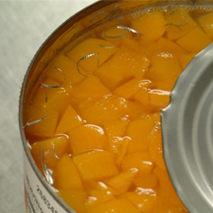
DVD Review
Can this be a physical contaminant?
A. Yes
B. No
2-11
Notes:
Instructor Notes
The answer is A. The can opener has left metal shavings in the canned food which are a physical contaminant.

Slide 12
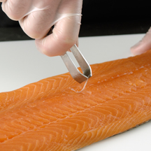
DVD Review
Can this be a physical contaminant?
A. Yes
B. No
2-12
Notes:
Instructor Notes
The answer is A. The bones in a fish filet are a physical contaminant if not removed.

Slide 13
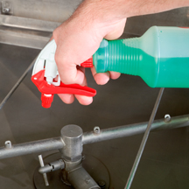
DVD Review
Is this a safe practice when handling chemicals? Why?
A. Yes
B. No
2-13
Notes:
Instructor Notes
The answer is B. The chemical spray bottle does not contain a label with the common name of the chemical.

Slide 14
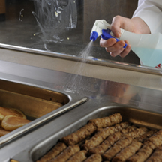
DVD Review
Is this a safe practice when handling chemicals? Why?
A. Yes
B. No
2-14
Notes:
Instructor Notes
The answer is B. The food handler is using the glass cleaner incorrectly by spraying it near food. This can contaminate the food.

Slide 15
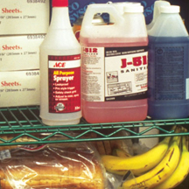
DVD Review
Is this a safe practice when handling chemicals? Why?
A. Yes
B. No
2-15
Notes:
Instructor Notes
The answer is B. Chemicals are being stored above food.

Slide 16
Additional Content
Some other things you should know…
2-16
Notes:
Instructor Notes
Teach the additional content not included in the DVD using the next several slides.

Slide 17
How Contamination Happens
Contaminants come from a variety of places:
Animals we use for food
Air, contaminated water, and dirt
People
Deliberately
Accidentally
2-17
Notes:
Instructor Notes
Contamination comes from a variety of places.
Contaminants can cause foodborne illness or result in physical injury.
Contaminants are found in the animals we use for food, air, water, dirt; and they occur naturally in food, such as bones in fish.
Food can be contaminated on purpose.
Most food is contaminated accidently.
Examples of accidental contamination include: food handlers who don’t wash their hands after using the restroom, and then contaminate food and surfaces with feces from their fingers; and food handlers who pass contaminants through illness.

Slide 18
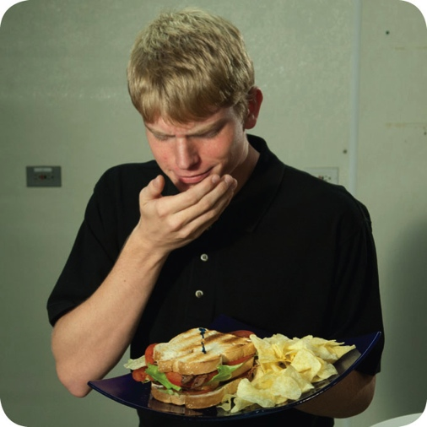
How Contamination Happens
People can contaminate food when:
They don’t wash their hands after using the restroom
They are in contact with a person who is sick
They sneeze or vomit onto food or food-contact surfaces
They touch dirty food-contact surfaces and equipment and then touch food
2-18
Notes:
Instructor Notes
Food handlers who don’t wash their hands after using the restroom may contaminate food and surfaces with feces from their fingers. Once the food that the food handler touched is eaten, a foodborne illness may result. This is called the fecal-oral route of contamination.

Slide 19
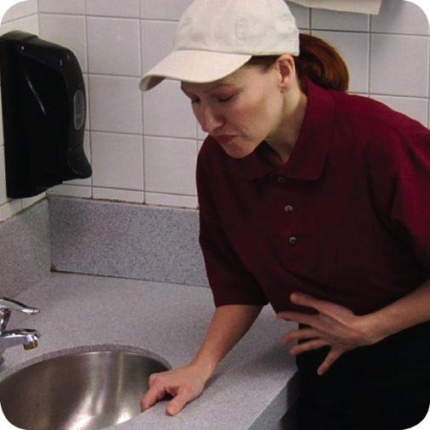
Biological Contamination
Common symptoms of foodborne illness:
Diarrhea
Vomiting
Fever
Nausea
Abdominal cramps
Jaundice (yellowing of skin and eyes)
Onset times:
Depend on the type of foodborne illness
Can range from 30 minutes to six weeks
2-19
Notes:
Instructor Notes
The symptoms of a foodborne illness vary depending on which illness a person has. But most victims of foodborne illness share some common symptoms.
Not every person who is sick from a foodborne illness will have all of these symptoms. Nor are the symptoms of a foodborne illness limited to this list.
How quickly foodborne-illness symptoms appear in a person is known as the onset time of the illness. Onset times depend on the type of foodborne illness a person has. They can range from 30 minutes to as long as six weeks. How severe the illness is can also vary, from mild diarrhea to death.

Slide 20
Activity
Teach the Bug
2-20
Notes:
Instructor Notes
Do the Teach The Bug Activity. This activity can be downloaded from ServSafe.com. Directions for using the activity are included with it.

Slide 21
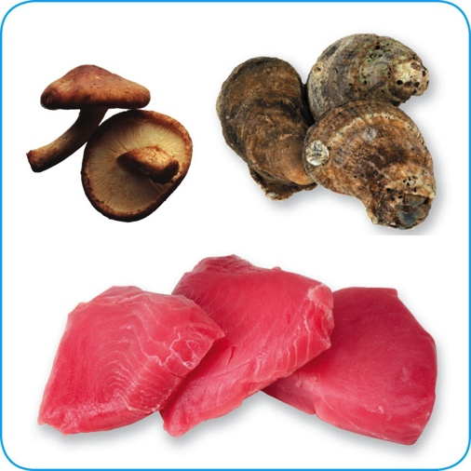
Biological Toxins
Origin:
Naturally occur in certain plants, mushrooms, and seafood
Seafood toxins:
Produced by pathogens found on certain fish
Tuna, bonito, mahimahi
Histamine produced when fish is time-temperature abused
Occur in certain fish that eat smaller fish that have consumed the toxin
Barracuda, snapper, grouper, amberjack
Ciguatera toxin is an example
2-21
Notes:
Instructor Notes
Some toxins are naturally associated with certain plants, mushrooms, and seafood. Toxins are a natural part of some fish.
Other toxins, such as histamine, are made by pathogens on the fish when it is time-temperature abused. This can occur in tuna, bonito, mackerel, and mahimahi.
Some fish become contaminated when they eat smaller fish that have eaten a toxin. One of these toxins is the ciguatera toxin. It can be found in barracuda, snapper, grouper, and amberjack. Shellfish, such as oysters, can be contaminated when they eat marine algae that have a toxin.

Slide 22
Biological Toxins
Illness:
Symptoms and onset times vary with illness
People will experience illness within minutes
General symptoms:
Diarrhea or vomiting
Neurological symptoms
Tingling in extremities
Reversal of hot and cold sensations
Flushing of the face and/or hives
Difficulty breathing
Heart palpitations
2-22
Notes:
Instructor Notes
Toxins cannot be destroyed by cooking or freezing. The most important way to prevent a foodborne illness is to purchase plants, mushrooms, and seafood from approved, reputable suppliers. It is also important to control time and temperature when handling raw fish.

Slide 23
Deliberate Contamination of Food
Groups who may attempt to contaminate food:
Terrorists or activists
Disgruntled current or former staff
Vendors
Competitors
FDA defense tool:
A.L.E.R.T.
2-23
Notes:
Instructor Notes
So far, you have learned about methods to prevent the accidental contamination of food. But you also must take steps to stop people who are actually trying to contaminate it. This may include the groups listed on the slide.
These people may try to tamper with your food using biological, chemical, or physical contaminants. They may even use radioactive materials. Attacks might occur anywhere in the food supply chain. But they are usually focused on a specific food item, process, or business.
The best way to protect food is to make it as difficult as possible for someone to tamper with it. For this reason, a food defense program should deal with the points in your operation where food is at risk.
The FDA has created a tool that can be used to develop a food defense program. It is based on the acronym A.L.E.R.T. It can be used to help you identify the points in your operation where food is at risk.

Slide 24
Deliberate Contamination of Food
Assure Make sure products received are from safe sources
Look Monitor the security of products in the facility
Employees Know who is in your facility
Reports Keep information related to food defense accessible
Threat Develop a plan for responding to suspicious activity or a threat to the operation
2-24
Notes:
Instructor Notes
Assure Make sure that products you receive are from safe sources. Supervise product deliveries. Use approved suppliers who practice food defense. Request that delivery vehicles are locked or sealed.
Look Monitor the security of products in the facility. Limit access to prep and storage areas. Locking storage areas is one way to do this. Create a system for handling damaged products. Store chemicals in a secure location. Train staff to spot food defense threats.
Employees Know who is in your facility. Limit access to prep and storage areas. Identify all visitors, and verify credentials. Conduct background checks on staff.
Reports Keep information related to food defense accessible: receiving logs, office files and documents, staff files, and random food defense self-inspections.
Threat Identify what you will do and who you will contact if there is suspicious activity or a threat at your operation. Hold any product you suspect to be contaminated. Contact your regulatory authority immediately. Maintain an emergency contact list.

Slide 25
Responding to a Foodborne-Illness Outbreak
Gather information
Ask the person for general contact information
Ask the person to identify the food eaten
Ask for a description of symptoms
Ask when the person first got sick
Notify authorities
Contact the local regulatory authority if an outbreak is suspected
2-25
Notes:
Instructor Notes
Ask the person making the complaint for general contact information and to identify the food that was eaten. Also ask for a description of symptoms and when the person first got sick.
Contact the local regulatory authority if you suspect an outbreak.

Slide 26
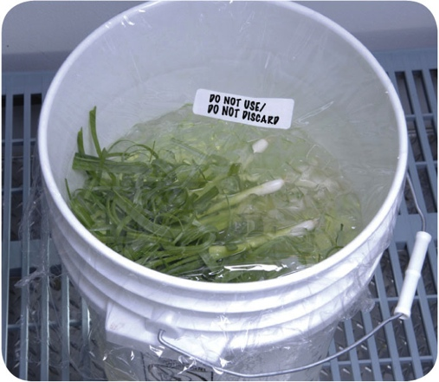
Responding to a Foodborne-Illness Outbreak
Segregate product
Set the suspected product aside if any remains
Include a label with “Do Not Use” and “Do Not Discard” on it
Document the information
Log information about suspected product
Include a product description, product date, lot number, sell-by date, and pack size
2-26
Notes:
Instructor Notes
Set the suspected product aside if any remains. Include a label with Do Not Use and Do Not Discard on it, as shown in the photo on the slide.
Log information about the suspected product. This might include a product description, production date, and lot number. The sell-by date and pack size should also be recorded.

Slide 27
Responding to a Foodborne-Illness Outbreak
Identify staff
Keep a list of food handlers scheduled at time of incident
Interview staff immediately
Cooperate with authorities
Provide appropriate documentation
Review procedures
Determine if standards are being met
Identify if standards are not working
2-27
Notes:
Instructor Notes
Maintain a list of food handlers scheduled at the time of the suspected contamination. These staff members may be subject to an interview and sampling by investigators. They should also be interviewed immediately by management about their health status.
Cooperate with regulatory authorities in the investigation. Provide appropriate documentation. You may be asked to provide temperature logs, HACCP documents, staff files, etc.
Review food-handling procedures to identify if standards are not being met or procedures are not working.

Slide 28
Review
Let’s review
2-28
Notes:
Instructor Notes
Review the content presented using the next several slides.

Slide 29
Review
Who Am I?
1. _____________________
I can be transferred to food or equipment by food handlers with feces on their fingers
People become contagious within a few hours of eating me
I am often linked with ready-to-eat food
Excluding staff with diarrhea and vomiting can prevent me from causing further illness
Norovirus
2-29

Slide 30
Review
Who Am I?
2. ________________________
I live in a person’s bloodstream and intestines
I am commonly linked with ready-to-eat food and beverages
I am in a person’s feces for weeks after symptoms have ended
Washing hands and cooking food to minimum internal temperatures can prevent me
Salmonella Typhi
2-30

Slide 31
Review
Who Am I?
3. _____________________
I am found in the feces of people I have infected
Flies can transfer me
I am linked with food easily contaminated by hands
Washing hands and excluding food handlers with diarrhea can prevent me
Shigella spp.
2-31

Slide 32
Review
Who Am I?
4. _____________________
I am often linked with ready-to-eat food
I’m often transferred to food by food handlers who have feces on their fingers
Excluding staff with jaundice can prevent me from causing illness
Normal cooking temperatures do not destroy me
Hepatitis A
2-32

Slide 33
Review
Who Am I?
5. ___________________________________________________
I can be found in the intestines of cattle
I produce toxins in a person’s intestines which cause illness
I am found in ground beef and contaminated produce
Excluding food handlers with diarrhea can prevent me from causing an illness
Enterohemorrhagic and shiga toxin-producing E. coli
2-33

